Slide 1

Library
Management

Slide 2

INTRODUCTION
NAME : KAPADIYA PRIYAM M.
ROLL NO : 126
ENROLLMENT NO : 23002170110064
BATCH : A-4
BRANCH : CE

Slide 3

Purpose of the project
Enhances customer experience.
manages customer relationships.
Provides reporting and analytics for books data.

Slide 4
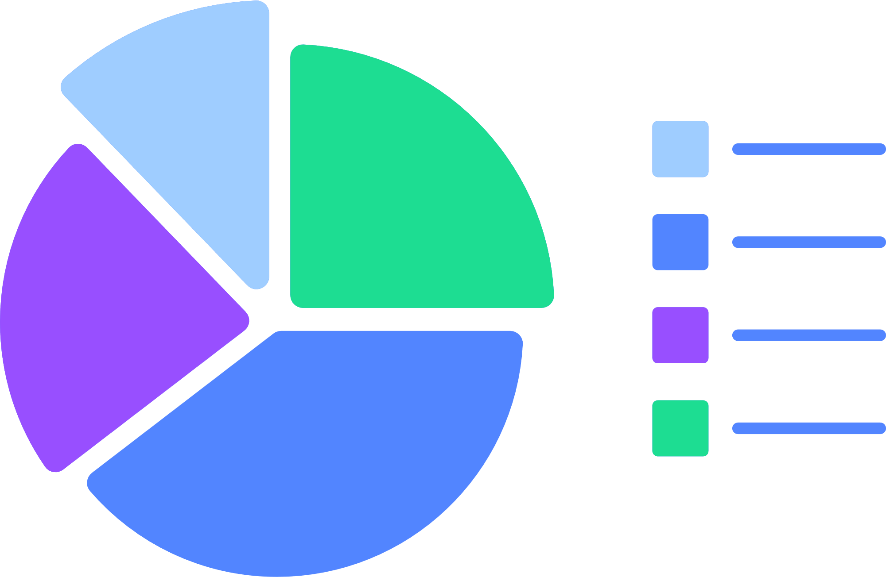
Functionalities of project
PYTHON | DATABASE MANAGEMENT
1. Exceptional Handling | 1.DML Quries for Library.
2. pgAdmin 4 is used for connection | 2.DDL Quries for LIbrary.
3. Matplotlib

Slide 5
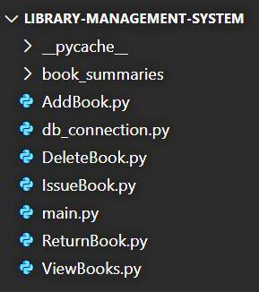
Used data Structures and class
List
Classes :

Slide 6

SQL Table
Tables :
CREATE TABLE books (
bid VARCHAR(20) PRIMARY KEY,
title VARCHAR(255) NOT NULL,
author VARCHAR(255) NOT NULL,
status VARCHAR(50) NOT NULL);
CREATE TABLE books_issued (
bid VARCHAR(50) NOT NULL,
issued_to VARCHAR(100) NOT NULL);

Slide 7
01
Merits
Convenience : Flexible books choices.
Cost Savings : it is free of cost.
Merits & Demerits
02
Demerits
Limited Options.

Slide 8
Future Scope
Mobile Application
Mobile Access: Develop a mobile app that allows users to search for books, make reservations, and check out books directly from their phones.
Push Notifications: Mobile apps can offer features like overdue reminders, new arrivals, or book availability updates via push notifications.

Slide 9
Thank
You.

